Slide 1
WOMEN EMPOWERMENT SCO IN COLLABORATION WITH PTA

Slide 2
OUR PRIDE OUR GREAT WOMEN OF AJ&K AND GB

Slide 3
Samina Baig
Ms Samina Baig has expedite Mount Everest in 2013, the lady from the small village of GB is the proud of nation
SCO took step a head a made her brand ambassador for promotion of products and services

Slide 4
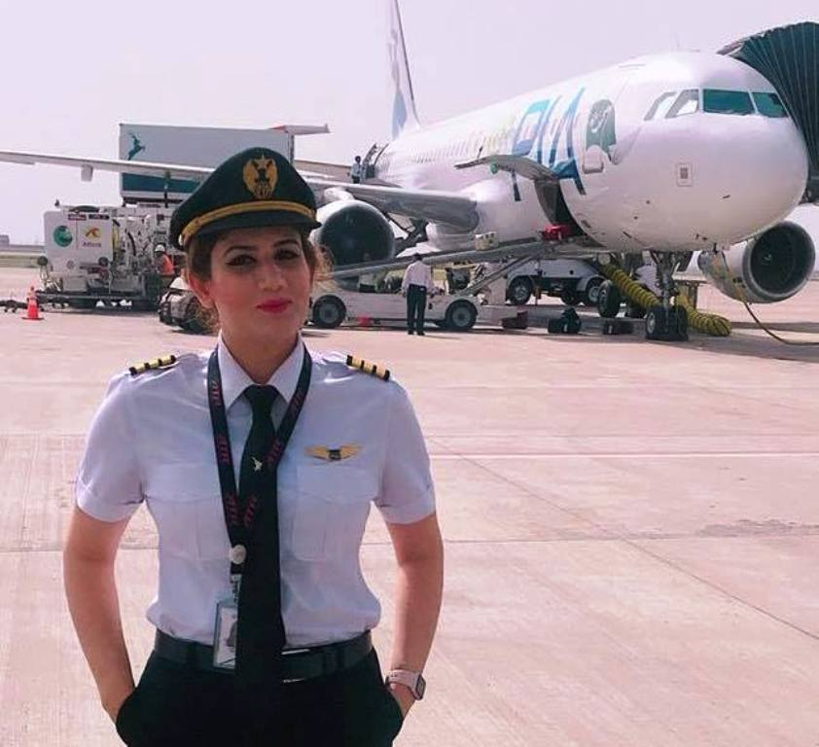
Maryam Mujtaba
Ms Maryam Mujataba has done a tremendous job for becoming first female commercial pilot from AJ&k
We are proud that she was also the brand ambassador of SCO for AJ&K

Slide 5
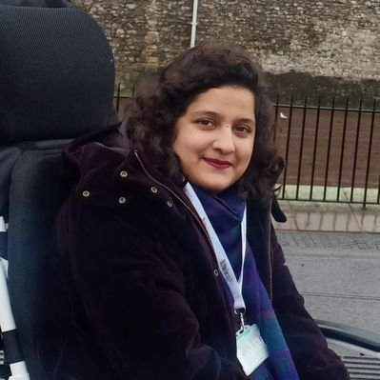
Anam Najam
Ms Anam Najam is Pakistan's first and only quadriplegic psychiatrist
She is a true face of velour & dauntlessness & a source of an inspiration from Azad Jammu & Kashmir and brand ambassador of SCO

Slide 6
SCO INITIATIVES FOR WOMEN EMPOWERMENT

Slide 7
Honorary Employment Program
SCO has given opportunity to young artist of AJ&K and GB to show their skills at national level by conducting Painting & Photography competitions at PNCA ISB
Mr & Mrs President has honored female artist of AJ&K and GB for their outstanding performance
SCO has given honorary employment to females for encouraging their talent

Slide 8
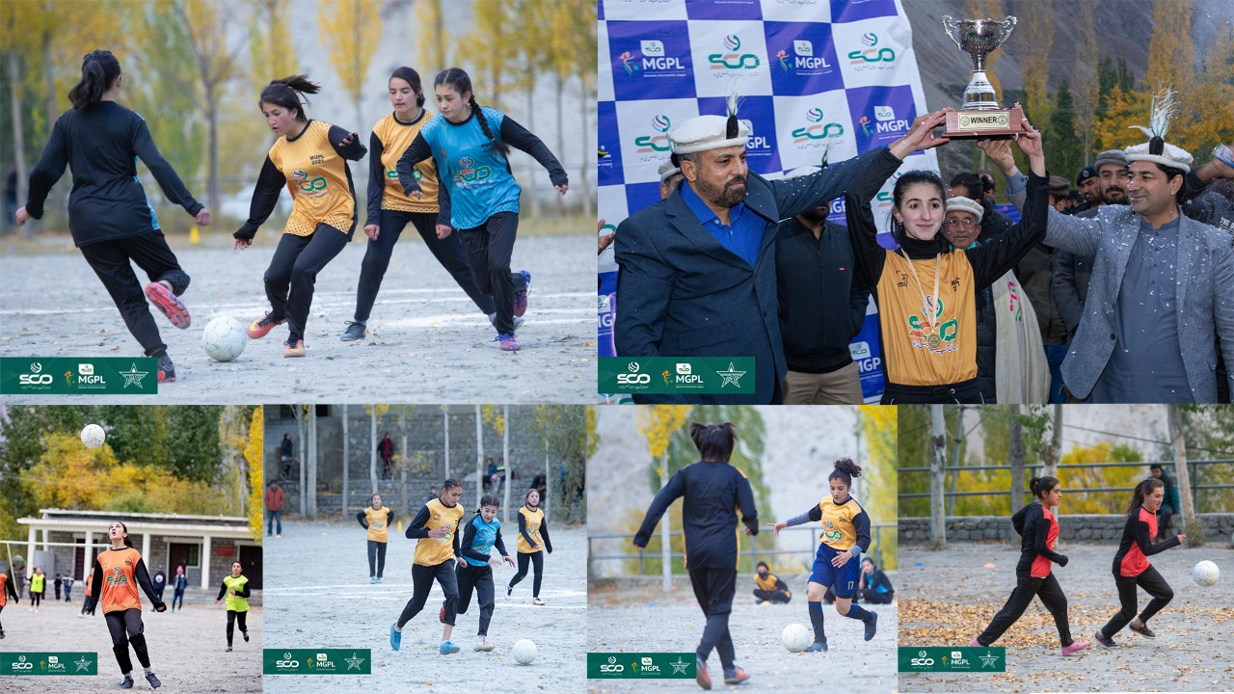
Sponsoring Female Sports
SCO Org MGPL at Gulmit Gojal, Hunza
11x teams and 130x players were participated in the tournament
National media and elec, print and social media of GB
Canadian Bloger Rosie Gabriel & Denmark Movie “Kids on Silk Rd” covered the event

Slide 9
Digital Bootcamp For Women
3 Day Long Digital Bootcamp for women of Gilgit Baltistan concluded with 25 women graduating and learning digital skills.
During the 3 days, these women identified their skills, built business models around the innovative ideas they proposed and utilized Digital skills to scale up the businesses. SCO sponsored the event by provision of space light refreshment/lunches & media coverage.

Slide 10
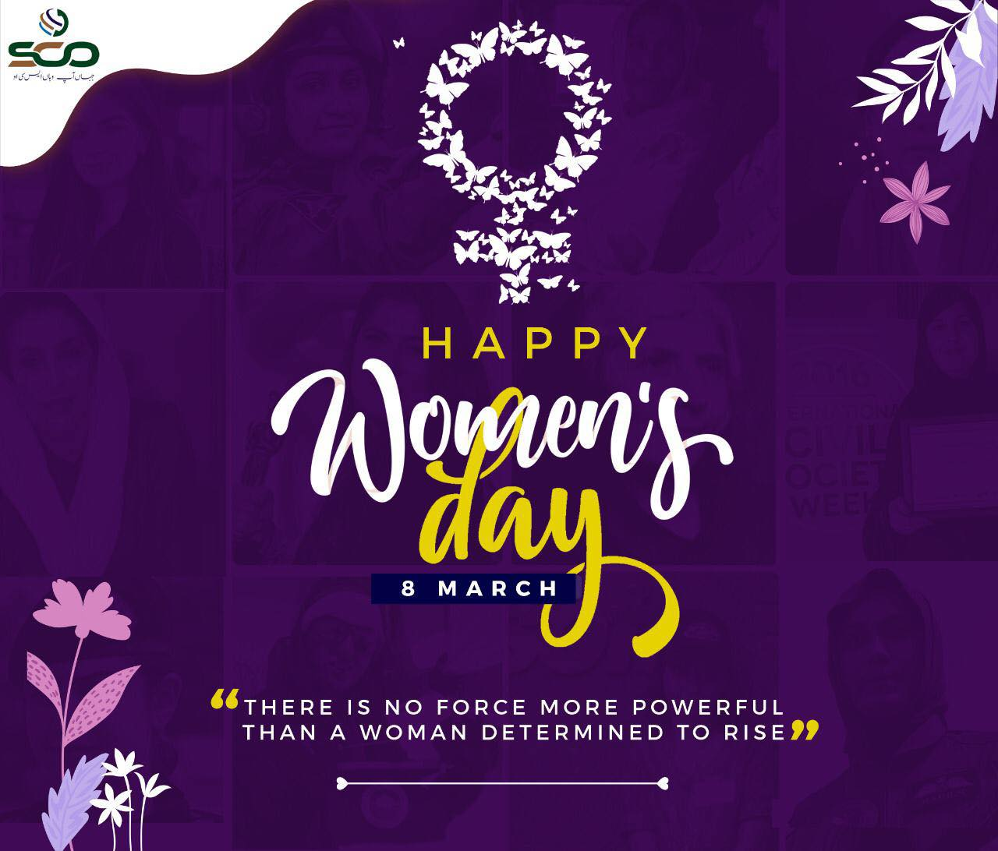
Celebration Of International Women's Day Every Year

Slide 11
SCO INITIATIVES In Collaboration With PTA For Women Empowerment 2022
SCO will organize seminar’s/workshops at Software Technology Park for Women on Basic digital skills and entrepreneurship training, Many females are members of SCO STP they will also help to train new entrants
SCO will contribute towards Programs for access to social security & entitlements, job link support and livelihood opportunities
For existing women entrepreneurs, a free of cost web site with online payment Gateway will be provided by SCO. This will link and provide trade facilitation for women with mainland
SCO has started E medical facility in Ajk and GB, hiring of females for operations of subject project along with on boarding of female SPaisa agents shall also be the part of initiative 2022 for women

Slide 12
THANK YOU

