Slide 1
Gender Inclusion in ICT,
Jazz joins hands with PTA
22, February 2022

Slide 2
DE&I STRATEGIC PILLARS AT JAZZ
People & Culture
Business
Community
Talent
Content
Livelihood
Leadership
Products
Public Image
Culture
Partners
Advocacy

Slide 3
INCLUSIVE PRODUCTS, MESSAGING AND BUSINESS OPERATIONS
Maximizing Impact on Lives and Livelihood of Women across Pakistan
Enabling economic contribution by women through our business operations, products and marketing messaging
Ensure that our content (including ads, website, public messages) across all communication channels is inclusive and accessible
Create products which promote gender equality, help reduce inequalities and promote economic growth of women
Content
Products
Build an inclusive supply chain by supporting SMEs, and SOHO (preferably women-led businesses)
Partners

Slide 4
EMPOWERING WOMEN THROUGH INCLUSIVE WORKPLACE PRACTICES
Signature Program for Career Development and Support Under DE&I
Creating opportunities for talent whether they are young professionals, moms or women who have taken a break in their career
She’s Back – Women Returnship Program
MOMentum – Phase back program for new moms
Phoenix – Women Development Program
Spectrum – Internship Program for Differently abled

Slide 5
“Jazz sustainability focus is on
digitally enabling youth, especially women”

Slide 6
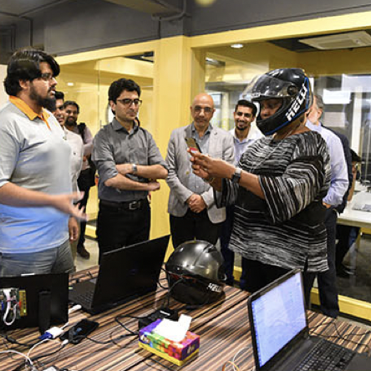
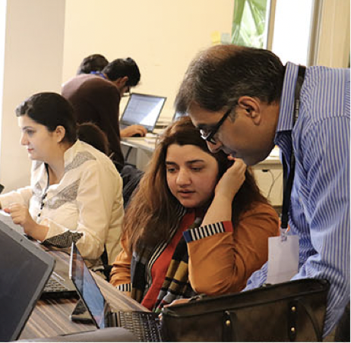
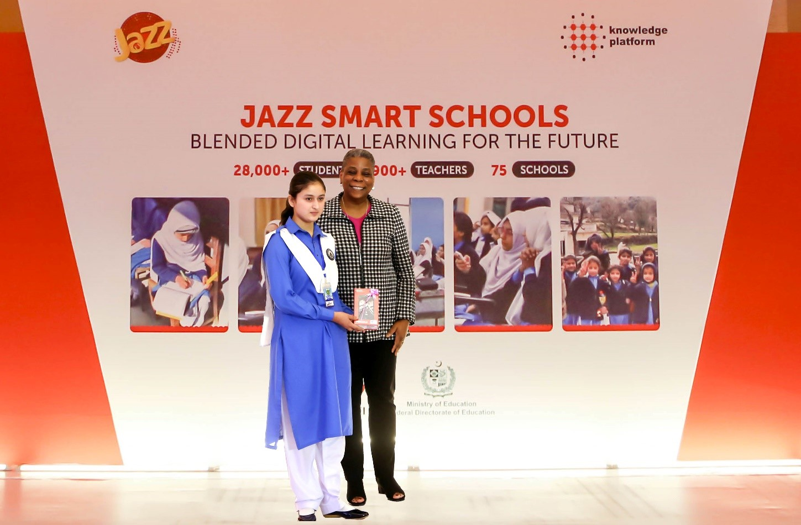
GENDER GAP MANAGED THROUGH CR PROGRAMS
Gender Inclusion
Bridging the digital divide by reducing the gender gap and introducing women economic empowerment initiatives
JAZZ-TCF ED-TECH INITIATIVE
JAZZ-UNDP
SDG BOOTCAMPS
Helping young people shape their future
Developing a network of tech-hubs across Jazz’s footprint to foster the local entrepreneurial ecosystem
JAZZ-UNDP
SDG BOOTCAMPS
JAZZ-NIC
STARTUP INCUBATION
Digital Skills & Literacy
Improving digital skills & literacy through educational initiatives
JAZZ-TCF ED-TECH INITIATIVE
JAZZ SMART SCHOOLS

Slide 7
1. JAZZ SMART SCHOOLS
Program Sponsor
Program Manager
Program Partner
Federal Directorate of Education
Planned
Beneficiaries
75 Female High Schools
500 Female Teachers
20,000 Female Students
Actual
Beneficiaries
75 Female High Schools
1,046 Female Teachers & Principals
38,453 Female Students

Slide 8
2. JAZZ-TCF ED-TECH

Slide 9
Creating Agents of Positive Change
274,841
Students across Pakistan
1,687
Purpose-built school units
1,200
All-female faculty

Slide 10
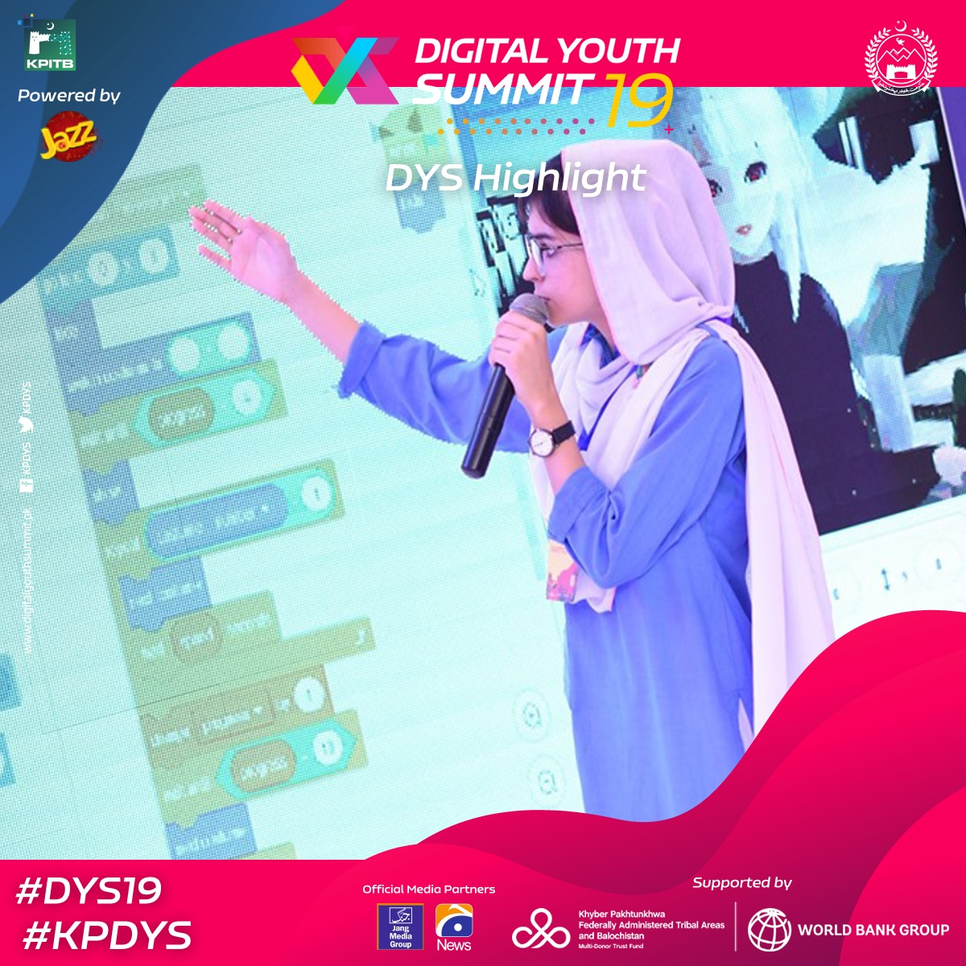
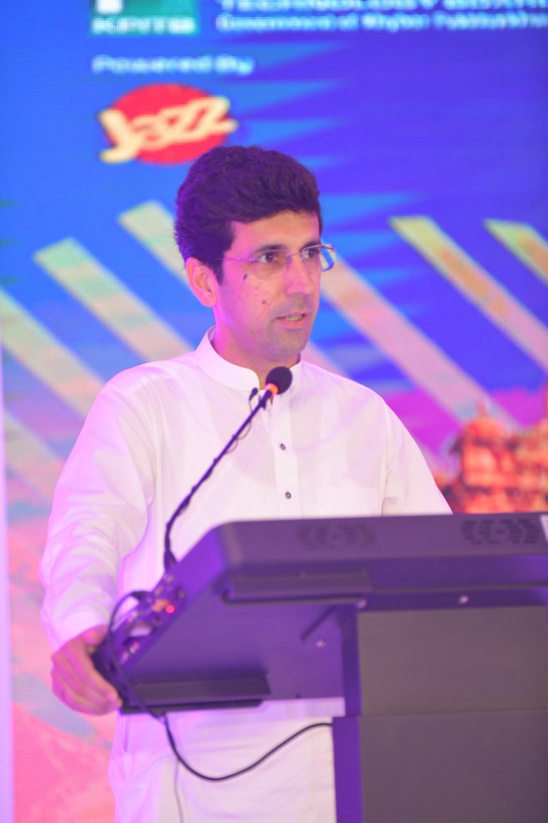
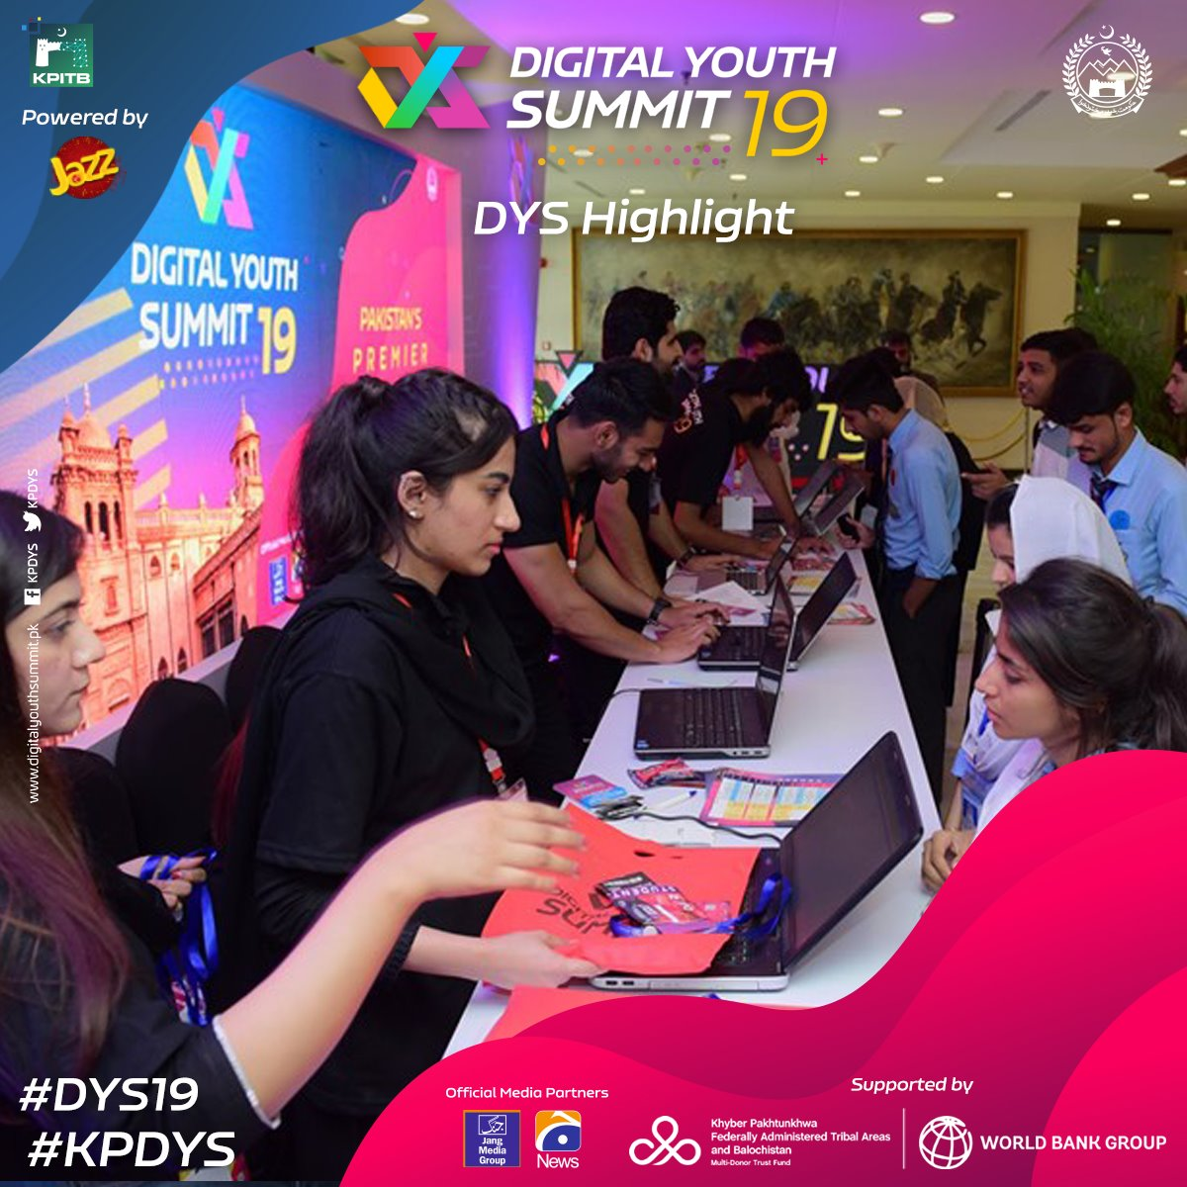
3. STRENGTHENING DIGITAL ECO-SYSTEM IN KPK
Program Sponsor
Program Manager
Technology Partner/Sponsor

Slide 11
4. JAZZ-UNDP SDG BOOTCAMPS
Program Sponsor
Program Manager
Technology Partner/Sponsor
5
20
Train
entrepreneurs
Regional (Sindh, Baluchistan, Punjab, KP, ICT/AJK/GB)
800
Bootcamps
GOALS
4
1
Thematic (Climate action, quality education, good health and well being, digital transformation)
National Bootcamp mega event

Slide 12
3 STAGE PROCESS
1
Capacity building of Social Entrepreneurs
Assist participants in progressing to the next stage through a well-rounded learning experience covering all aspects of their enterprise.
2
Mentoring Sessions
Build on the learning from the first stage to provide specific mentoring on real issues faced by the enterprises to prepare them for incubation.
3
Funding
Provide opportunities to pitch at different forums, linkages with potential investors and grants.

Slide 13
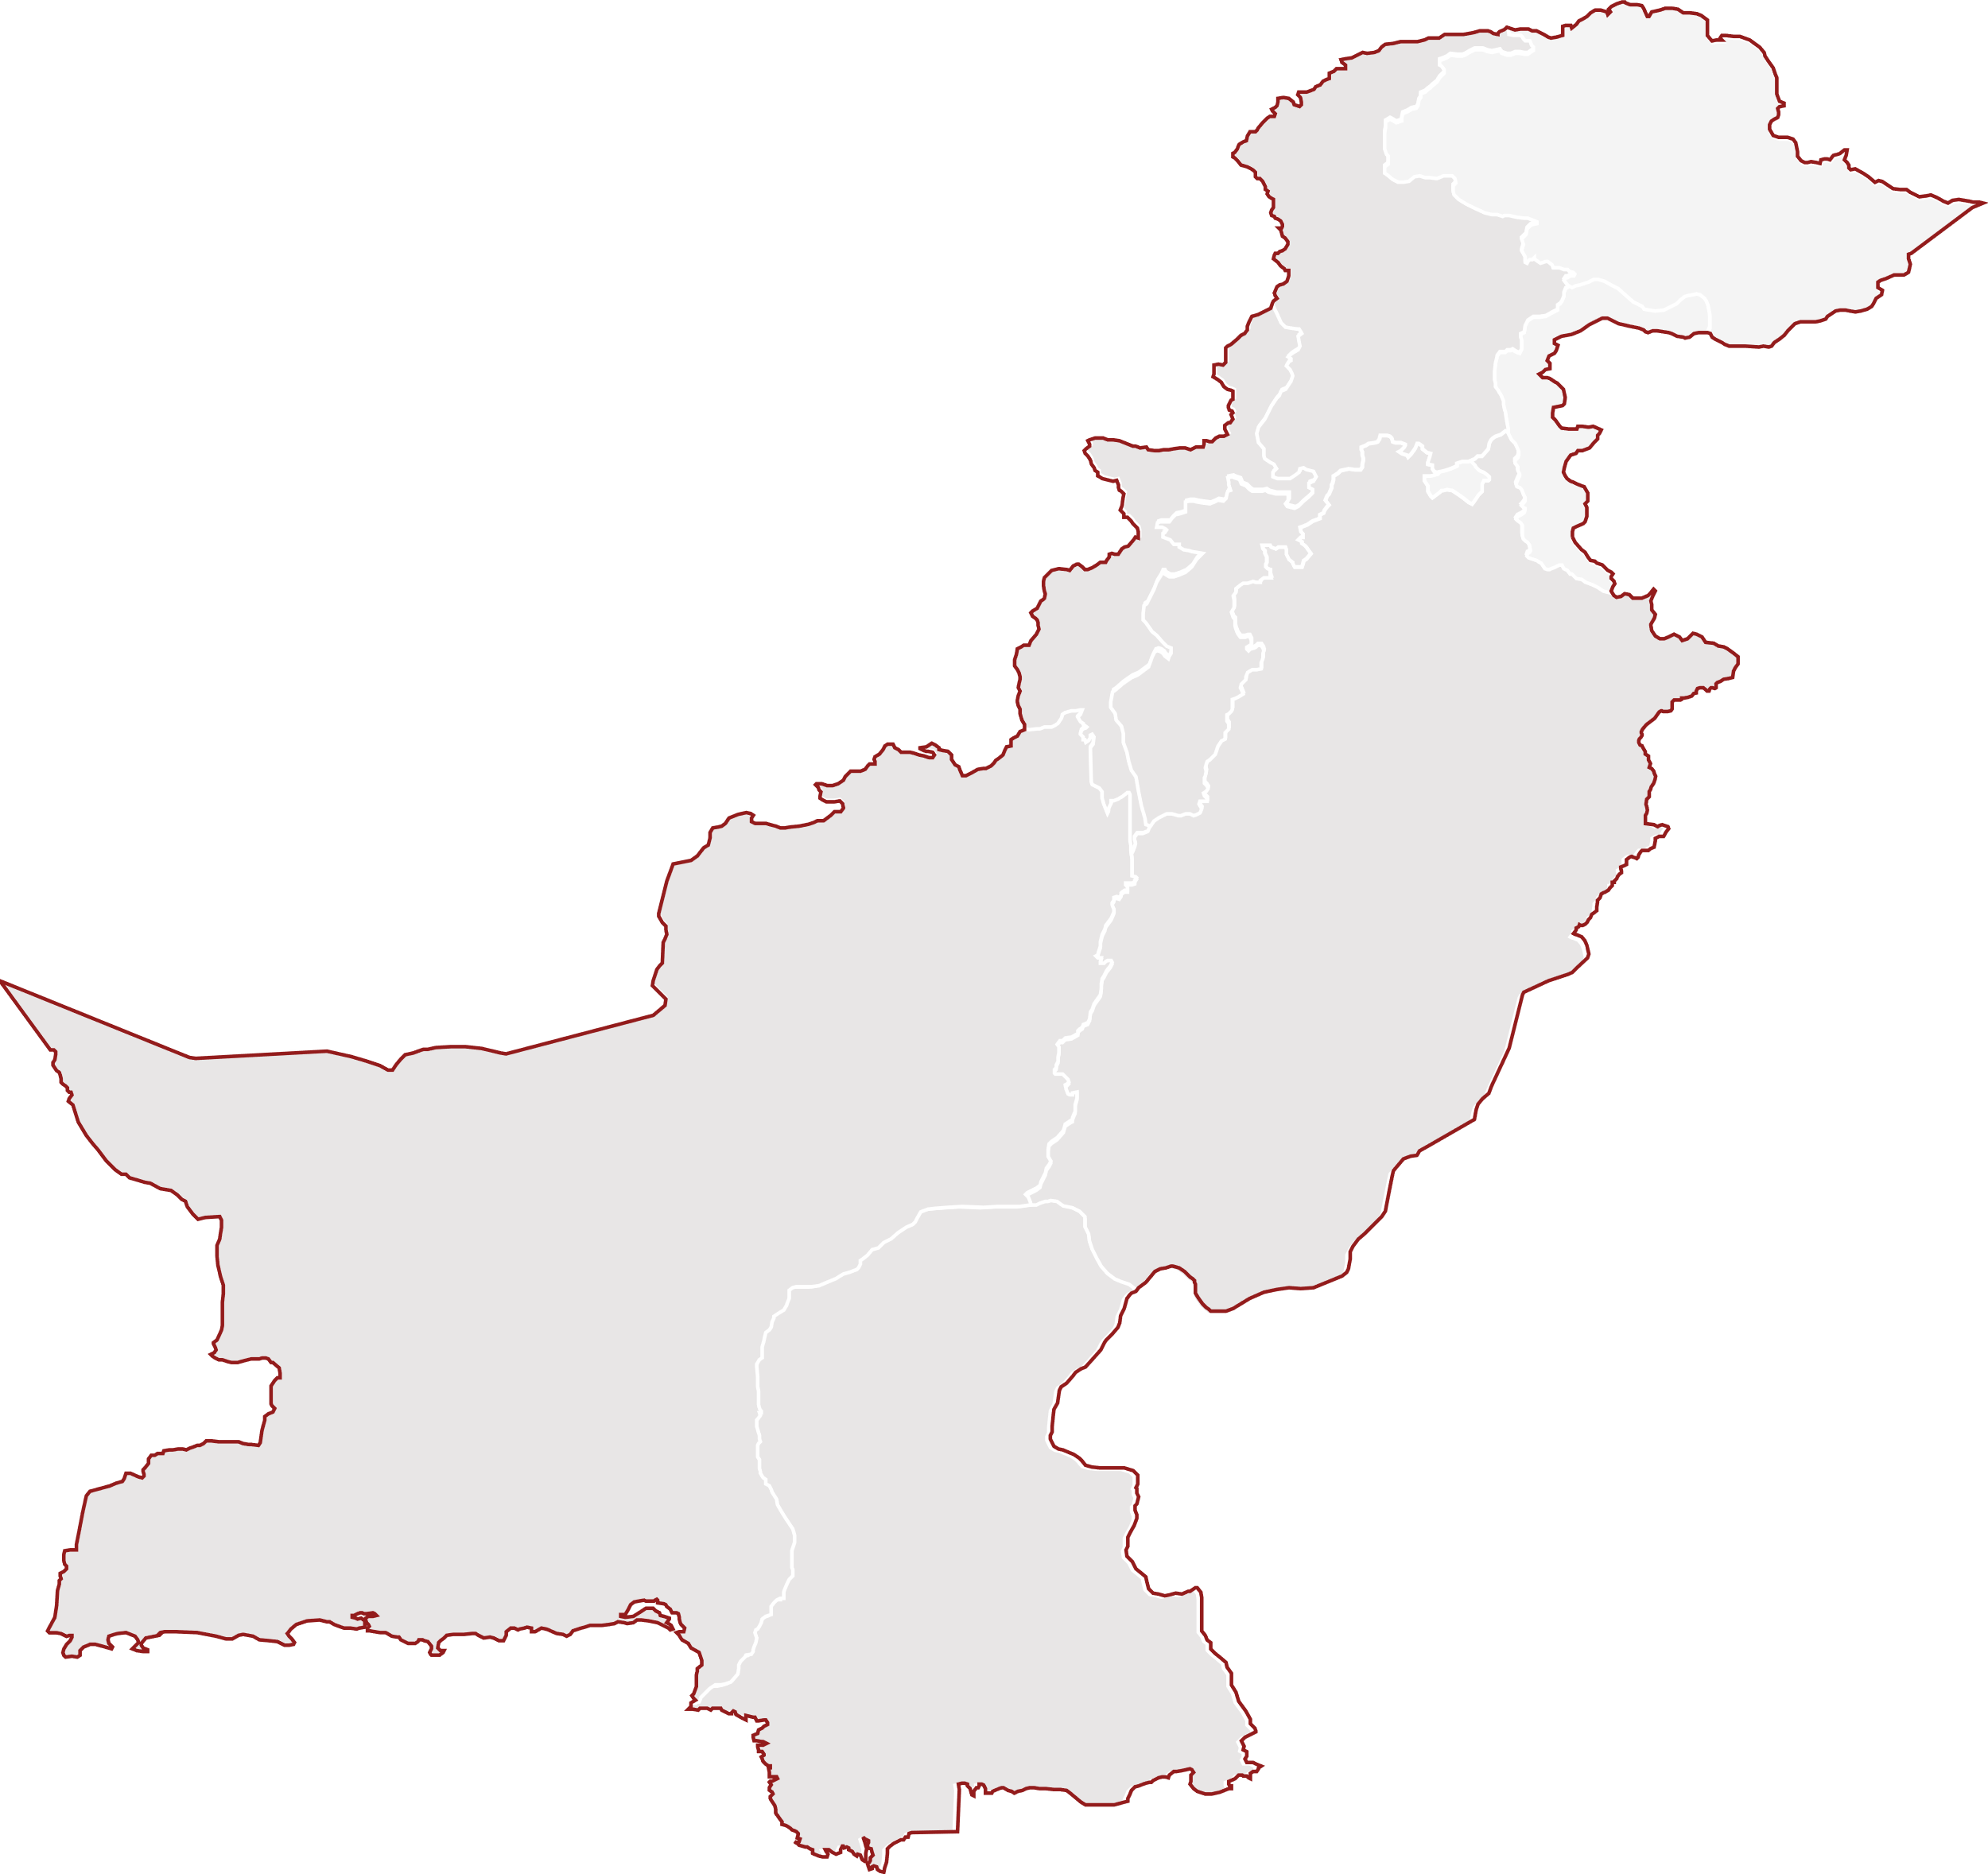
JAZZ-UNDP SDG BOOTCAMPS’ ACHIEVEMENTS
KPK
35%
65%
Female participants
Male participants
12
19
Punjab
SDGs
Targeted
Social Enterprises Engaged
60%
40%
Female participants
Male participants
Baluchistan
21
11
43%
57%
SDGs
Targeted
Social Enterprises Engaged
Female participants
Male participants
09
13
Sindh
SDGs
Targeted
Social Enterprises Engaged
55%
45%
Female participants
Male participants
14
17
SDGs
Targeted
Social Enterprises Engaged

Slide 14
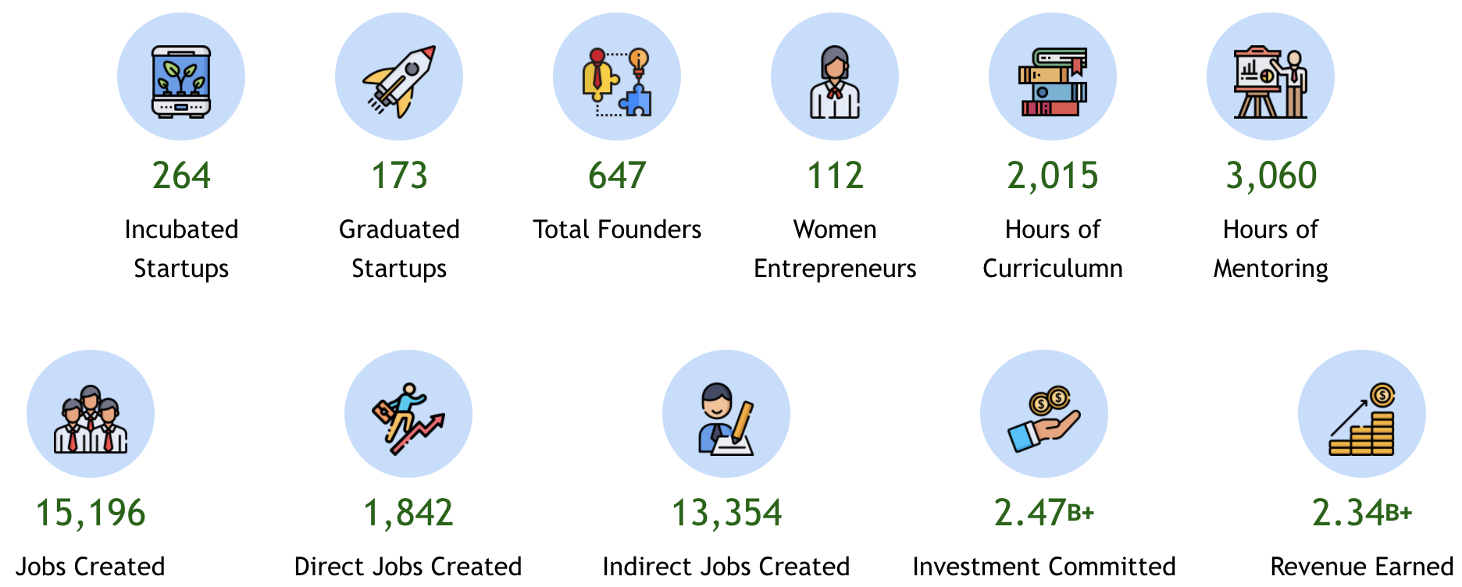
5. NIC - INCUBATION CENTRE FOR STARTUPS
Program Sponsor
Program Manager
Implementing Partner
112 Women Entrepreneurs
17% of Total Incubated Startups

Slide 15
RECOGNITION
Global Good Award 2019 for Jazz Smart School
GDEIB Award 2021 for best practice in Community, Government Relations and Philanthropy
OICCI Women Empowerment Awards 2021 for Driving Change Beyond Workplace

Slide 16
2022 COMITMENTS WITH PTA
Female teachers training on digital skills from 1,200 to 6,000
Dedicated SDG Bootcamp for female social enterprises in collaboration with PTA
Women4Tech summit in collaboration with GSMA and PTA
Awareness campaigns for gender inclusion in ICTs
Female focused prodcuts, sim sale activity and handsets on installments for females during events
Female specific support through dedicated experience centers/booths
An enabling workplace that is inclusive, accessible and empowering for female employees

Slide 17
Gender Inclusion at Jazz
22, February 2022

