Slide 1

ZONG’S COLLABORATION
WITH PTA FOR
“GENDER INCLUSION IN ICTs”

Slide 2

ZONG’S FOCUS ON GENDER DIVERSITY & INCLUSION
DIGITAL
ZONG 4G – Frontrunner in promoting Prime Minister’s Vision of Digital Pakistan through stimulating Business Integrated CSR Collaborations

Slide 3
Zong 4G – Our Diversity Journey
Taking it to the Next Level
Accelerating Gender Diversity through
Digital Innovation
2021
2022
A year of Impactful initiatives focused on promoting
Gender Inclusion
Zong 4G – Relentlessly Committed to Building a more inclusive workplace and society
Notes:
boosting

Slide 4
Leader in the industry for promoting women empowerment
In 2022, Building on the Success of Last Years to further Boost Gender Diversity Initiatives and make this year a bigger success with greater contribution
ZONG 4G - DIVERSITY FRONTRUNNER
OUR JOURNEY CONTINUES

Slide 5
Zong’s Best Practices for GENDER INCLUSION in the Previous Years

Slide 6
GENDER INCLUSION IN ICTs
ZONG – A STRONG ADVOCATE OF GENDER DIVERSITY & INCLUSION
More than 1200
female employees from diverse backgrounds are
working with Zong nationwide
across all levels of hierarchy
40+
Chinese & Pakistani Female are in leadership roles
GTOs
Fresh female graduates hired through GTO program; trained & provided with opportunities to grow
280+
Female CSOs in
Call Centers,
serving nationwide customers

Slide 7
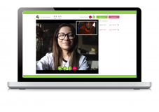

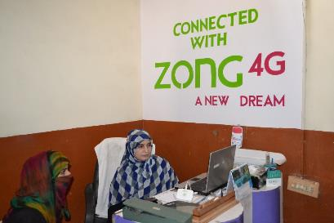
GENDER INCLUSION IN ICTs
LEADING THE DIGITAL INNOVATION –
E HEALTH
ENSURING FEMALE DOCTORS RESUME WORK THROUGH CONVENIENCE OF THEIR HOMES TO PROVIDE TREATEMENT IN REMOTE AREAS

Slide 8


GENDER INCLUSION IN ICTs
LEADING THE DIGITAL INNOVATION –
E HEALTH
12,000 free e-consultations through female doctors only in collaboration with
Sehat Kahani
ALIGNED WITH DIGITAL PAKISTAN;
PROMOTING WOMEN ENTREPRENEURS

Slide 9
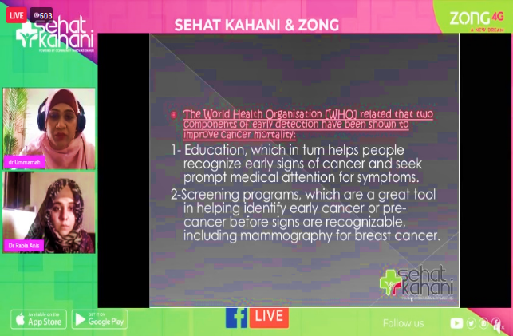
GENDER INCLUSION IN ICTs
LEADING THE DIGITAL INNOVATION –
E HEALTH
Online
“Breast Cancer Awareness”
session for all Zong employees and their families
SPREADING HEALTH AWARENESS REGARDING
BREAST CANCER PREVENTION

Slide 10

GENDER INCLUSION IN ICTs
LEADING THE DIGITAL INNOVATION –
E HEALTH
Online open house awareness session on COVID-19 Omicron Variant for all Pakistanis
ZONG SEHAT HOUR, AN ON-GOING DIGITAL LEARNING AND HEALTH AWARENESS INITIATIVE

Slide 11

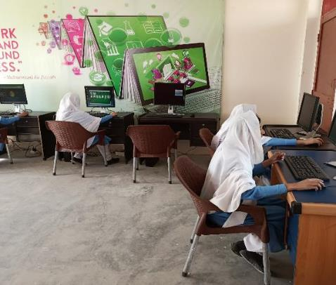
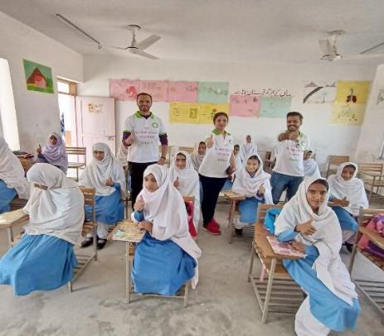
GENDER INCLUSION IN ICTs
LEADING THE DIGITAL INNOVATION –
E EDUCATION
200 +
Families benefitted
DIGITAL LAB ESTABISHED AT PAK CHINA FRENDSHIP SCHOOL FOR 200+ FEMALES IN GAWADAR

Slide 12
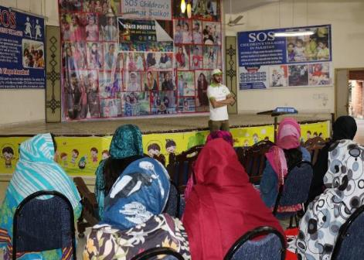
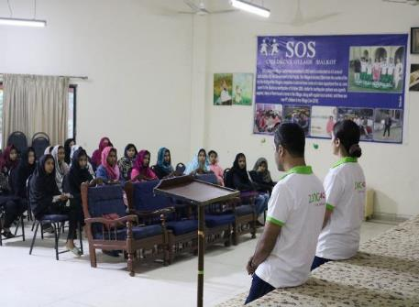
GENDER INCLUSION IN ICTs
LEADING THE DIGITAL INNOVATION –
E EDUCATION
100 + Families
benefitted
DIGITAL TRAINING AND SOCIAL MEDIA PROGRAM FOR 100+ FEMALES AT SOS VILLAGE SIALKOT

Slide 13
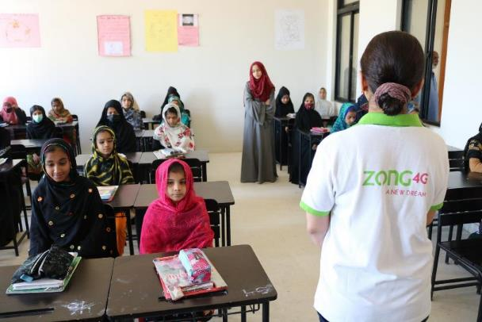
GENDER INCLUSION IN ICTs
LEADING THE DIGITAL INNOVATION –
E EDUCATION
200 + Families
benefitted
IT SKILLS/ DIGITAL LITERACY TRAINING FOR 200+ FEMALES AT
DUMBA GOTH, KARACHI

Slide 14
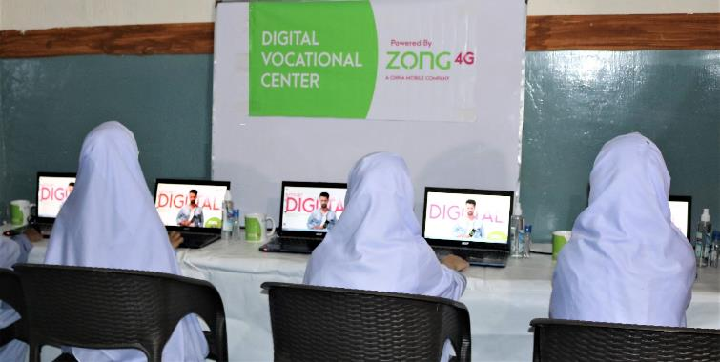
GENDER INCLUSION IN ICTs
LEADING THE DIGITAL INNOVATION –
CIVIC DUTY
100 + Families
benefitted
WOMEN VOCATIONAL CENTER AT
DUR-E-YATEEM ORPHANAGE IN ISLAMABAD FOR 100+ FEMALES

Slide 15
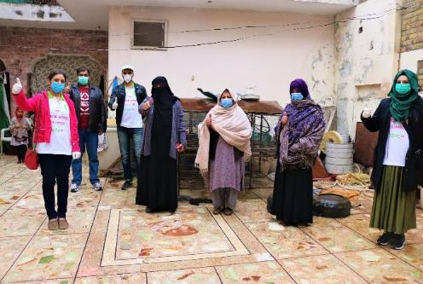
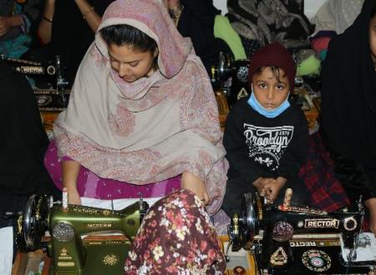

GENDER INCLUSION IN ICTs
LEADING THE DIGITAL INNOVATION –
CIVIC DUTY
50 + Families
benefitted
WOMEN VOCATIONAL CENTER IN RAWALPINDI SUPORTING
50+ FAMILIES

Slide 16
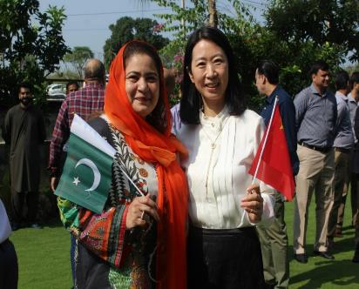
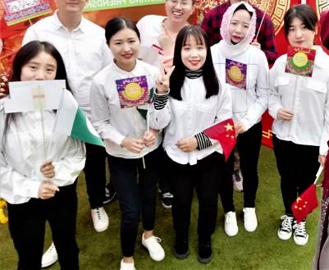

GENDER INCLUSION IN ICTs
LEADING THE DIGITAL INNOVATION –
CALL CENTERS MODEL
CALL CENTERS WITH 49% FEMALE STAFF, BOTH LOCAL AND CHINESE. WORK-FROM-HOME MODEL OF CALL CENTERS IS OF INTERNATIONAL STANDARDS

Slide 17
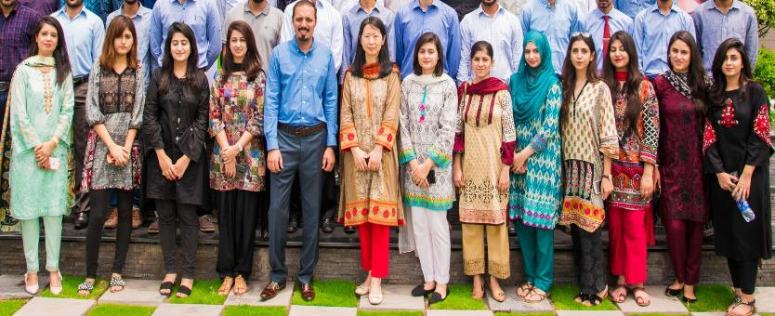
GENDER INCLUSION IN ICTs
LEADING THE DIGITAL INNOVATION –
GTO PROGRAM
DEVELOPMENT AND CAREER GROWTH OPPORTUNITIES FOR FEMALE GRADUATES THROUGH GTO PROGRAM

Slide 18
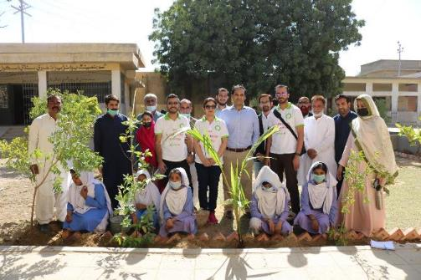
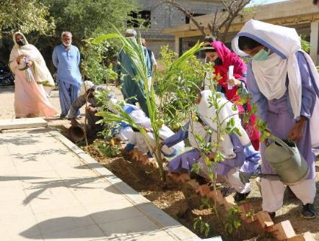
GENDER INCLUSION IN ICTs
LEADING THE DIGITAL INNOVATION –
CLEEN GREEN PAKISTAN
150+
Female Students
PLANTATION DRIVE WITH 150+ FEMALE STUDENTS IN KARACHI TO PROMOTE VISION OF GREEN PAKISTAN

Slide 19
OTHER INITIATIVES
Yearly Celebration of International Women’s Day
Focus on Mental & Physical health of female employees
  Regular health check-ups
  Free medical coupons
  Health awareness and mental well-being sessions
  Breast cancer awareness programs
  Provision of sports facilities and well-equipped gym
  Regular yoga sessions for females
Facilitation services for working mothers
  State-of-the-art day care facilities
CSR Ambassador Program: A Platform for Zong Female Volunteers to Uplift Women in Society
Supporting females in times of crisis and calamities
  Continuous support during COVD-19 pandemic (SOS Village collaborations)
  Support during floods to Bint-e-Fatima Old Age Homes
SERVING THE MARGINALIZED STRATE OF SOCIETY

Slide 20
Zong’s Continuation of Gender Initiatives – Future Plans

Slide 21

GENDER INCLUSION IN ICTs
Year 2022, A Year of Further Milestones for Zong on Gender Inclusion

Slide 22

GENDER INCLUSION IN ICTs
Zong in collaboration with PTA

Slide 23
GENDER INCLUSION IN ICTs
We Applaud PTA’s efforts for Paving the Path Towards Gender Diversity & Inclusion and Commit to Excel this journey through Zong’s Collaboration with PTA

Slide 24

Zong’s Sustainable Gender Inclusion Goals in collaboration with PTA
Special Products for New & existing female customers
2
1
3
For New Sales
For Existing Customers
22% of current registered CNIC are against Females
Special tariff packages/ incentives in new sales for female customers in forms of extra minutes and data
Special package/ subsidized bundles for existing female customers to cover all their communication needs in an economical way
Ambition is to grow by 5% in 2022

Slide 25






Targeted Campaigns on Digital & Social Media
4
Special internet awareness campaigns on electronic and social media for awareness and to ensure continued affinity with its female audiences
International Women's Day
International Girls in ICT Day
International Day of the Girl Child
International Day of Rural Women
Breast Cancer Awareness Day
International Day of Women and Girls in Science
Days
Platforms
Facebook
Instagram
Twitter
YouTube

Slide 26
Zong’s Sustainable Gender Inclusion Goals in collaboration with PTA
Dedicated Female Priority Queue at all Zong CSCs to facilitate women consumers
Franchises to follow same SOPs of Female Priority SIM Issuance
Female representatives in the sales channels of the company, especially in rural areas
Special SIM sale activity for females across Pakistan and AJK GB on quarterly basis

Slide 27
Zong’s Sustainable Gender Inclusion Goals in collaboration with PTA
  Design female staff group for staff activates and DOD activities for SIM Sale Activity
  Design Special SIM Card Artwork to promote Gender Inclusion in Pakistan
  Franchises and retailers to make Women Inclusion part of every event
  Celebration of women-focused days at all CSCs through branding

Slide 28
Zong’s Sustainable Gender Inclusion Goals in collaboration with PTA
  Female Volunteer Digital Education Program for the under-privileged women
  Online Awareness Programs- on women safety & security
  Digital Labs for across the country for promoting women growth and empowerment
  Promotion of e-education through various partnership

Slide 29


GENDER INCLUSION IN ICTs
CSR INITIATIVES
COLLABORATION WITH EHSAAS PROGRAM
WOMEN EMPOWERMENT PROGRAMS
  Ehsaas-Women Empowerment Centers
  Digital Learn & Earn Model for Females at Home
  Collaboration with Women Oriented Partners

Slide 30

GENDER INCLUSION IN ICTs
CSR INITIATIVES
COLLABORATION WITH PSDF
E-EDUCATION
  10,000 STUDENTS FREE E-EDUCATION ON FREE LANCING
    5000+ FEMALE STUDENTS
    FREE DATA BUNDLES
  TOP PERFORMING FEMALE STUDENTS SHALL GET TABLETS FOR PROMOTION OF DIGITAL EDUCATION
    300 TABLETS

Slide 31
GENDER INCLUSION IN ICTs
CSR INITIATIVES
E-EDUCATION
  DIGITAL LABS ACROSS THE COUNTRY FOR FEMALES
  IT SKILLS/ DIGITAL LEARNING AND FREELANCING EDUCATION TO FEMALES IN FAR FLUNG AREAS
  DONATION OF TABLETS FOR FEMALE STUDENTS

Slide 32
GENDER INCLUSION IN ICTs
CSR INITIATIVES
E-HEALTH
  Online health awareness sessions and campaigns
  Free e-consultations for females

Slide 33


Thank you!

