Slide 1
Telenor Pakistan in collaboration with PTA #HerDigitalPakistan Accelerating Gender Inclusion in ICTs February 2022

Slide 2
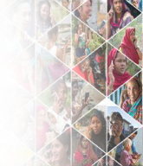
GSMA Connected Women
Reducing internet gender gap by connecting more women to mobile internet
5% increase in female internet user base
*from 23% to 27% since 2020
Way Forward:
In collaboration with PTA increase female mobile internet user-base to 30% by 2023:
Encouraging women focused SIM sales in underserved areas
Promoting female participation in the sales and channels work force

Slide 3
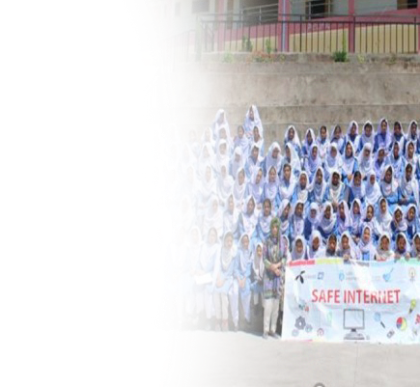
Safe Internet
Promoting Child Online Protection and responsible use of the Internet, specifically amongst girls
500,000
15,000+
Nationwide Outreach
(across all provinces and territories of Pakistan) with special focus on girls and persons with disabilities
Girls trained out of 1 million students across public and private schools of Pakistan
teachers upskilled
on enabling child online protection
Way Forward:
In collaboration with PTA & ITU
Train 100,000+ girls in 2022 at schools and vocational training institutes across Pakistan
Train 1000+ female teachers in 2022 at schools and vocational trainings institutes across Pakistan

Slide 4
Open Mind Pakistan
Enabling inclusion of persons with disabilities, specifically girls, by creating employment and skills development opportunities for a digital future
75%
120+ Open Mind Graduates with 30% females
8 Successful annual iterations
Placement rate. Nationwide placements across all facets of teleco business
Way Forward:
Onboarding PTA on Disability Job Portal in 2022 as lead partner
Hire 15 PWDs including girls in 2022 (Batch 9) in compliance with the legal quota
Job placement of 1 female Person with Disability at PTA

Slide 5
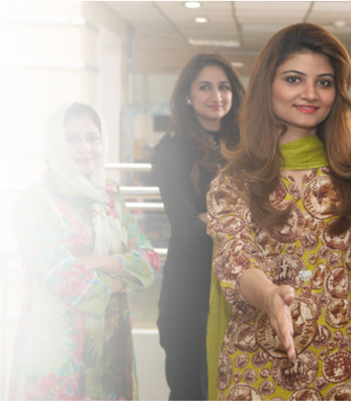
Naya Aaghaz
Promoting gender diversity by providing work opportunities to women on career breaks
39%
120+ Naya Aghaaz
Graduates
6 Successful annual iterations
Successful internal placement rate of collectively
on different positions at Telenor Pakistan
Way Forward:
Hiring 15 Naya Aghaaz Associates in 2022 (Batch 7)

Slide 6
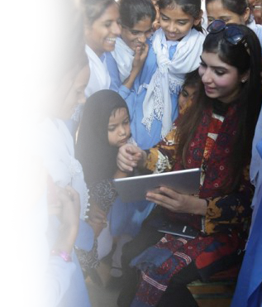
Taleemabad
Digital learning to augment the single national curriculum and empower teachers and educators
768,000
Female students empowered and educated (60% of total)
Way forward:
Enroll 125,000 additional out of school girls in 2022
Establish 6 Model Virtual Schools for girls at Federal territory

Slide 7
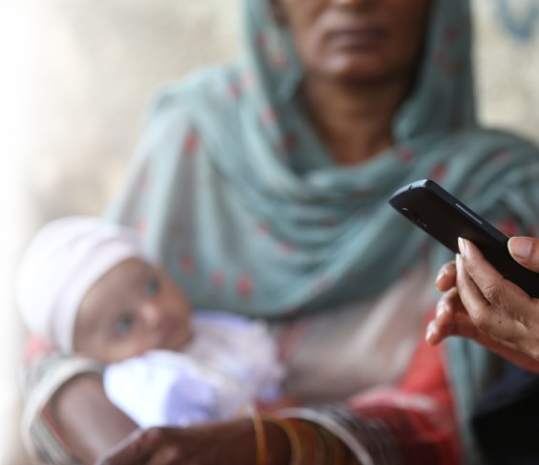
Digital Birth Registration
To extend the fundamental right of identity to the children of Pakistan
1.3 Million
Girls out of total 2.5 million children registered
Way Forward:
Institutional mainstreaming of the DBR system
Scaling Digital Birth Registration system beyond pilot districts across the provinces

Slide 8
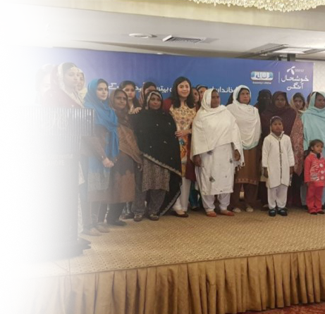
Khushal Aangan
To empower rural Pakistani women by providing them awareness and information health & nutrition, livestock & household management and internet literacy
500,000+
women subscribers from mostly rural and Agri-focused regions of Pakistan
Way Forward:
To continue educating females using ICTs to be financially independent
To continue promoting agri and home based livelihood for women in rural Pakistan

Slide 9
Thank You
Society is Unity in Diversity
- George H Mead

